Slide 1


Cyber Dawgs: Linux Crash Course
Bryan Vanek
Cwit t-site scholar
Cyber defense club president

Slide 2
What will we be covering in this presentation?
The basics of operating in and using Linux/the command line
File/directory navigation & management
Users, Groups, and Permissions
Working with a simple text editor
The Linux directory structure

Slide 3

So…what is Linux?
An open source operating system based off of UNIX
Developed by Linus Torvalds in 1991
Several different ‘flavors’ of Linux exist…
Red Hat/Enterprise
Fedora
Ubuntu
Debian
CentOS (what you have installed, and is also my personal favorite!)

Slide 4
Mkay, but I like Windows or Mac OSx. Why should I use Linux (or a command line interface)?
Windows and Mac OSx have their merits for things like compatibility and familiarity, but…
Linux is FREE, so lots of businesses use it
It’s an extremely efficient OS, and each distro gets a lot of revisions
In terms of specifications, it’s very resource friendly!
For command line interfaces, it’s all about interfacing…
GUIs (Graphical User Interfaces) are nice-to-haves in the working world
It’s also a nice skill to have!

Slide 5
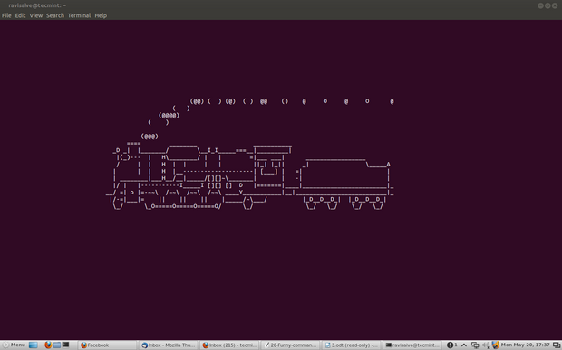

BUT WAIT…what’s a command line interface?
A non-graphical user interface for a computer’s operating system
Basically, it lets you talk to your computer in a text-based environment.
A lot of (if not all) OSs have something like this!
In Linux or Mac OSx, this is referred to as the ‘terminal’
In Windows, this is called the ‘Command Prompt’

Slide 6

Okay, so I can command prompt now… but now what?
YOU CAN DO SO MANY AMAZING THINGS!!!
What we’ll be going over now are some useful commands that will prepare you for the rest of the week in using your Linux environment!
Don’t be afraid to ask questions! You can take notes or follow along in your CentOS environment if you want!

Slide 7
THE MOST IMPORTANT COMMAND OF THEM ALL
The ‘man’ command
Short for manual
Used to list and display command manual pages
Usage example 1 (UE1): ‘man man’ (yes, man has its own man page)
UE2: ‘man ls’
EVERY COMMAND HAS THIS. If you forget how to use a command or want to know if it can do something, use this!

Slide 8
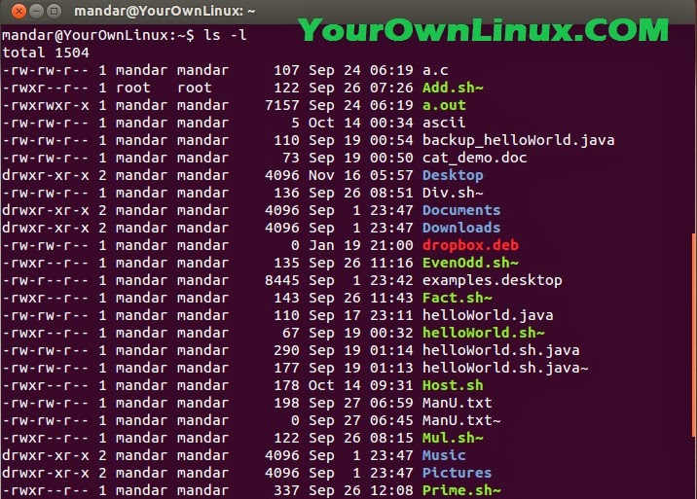
Moving on to directory navigation commands…
The ‘ls’ command
Stands for list directory
Lists all of the current directory contents!
UE1: ls
UE2: ls -l
UE3: ls -la
Wait a sec…what are those dash letter things at the end?
A quick talk about options!!

Slide 9
AND NOW BEGINS THE FLOOD OF COMMANDS
cd (stands for ‘change directory’): lets you change directories
UE: cd /home/<your username>
Special characters: ~, ., .., /
pwd (stands for ‘present working drectory’): lets you know where you are!
A lot more useful than it sounds!!
mkdir (make directory): lets you make a directory (or ‘folder’)
UE1: mkdir test_dir1
UE2: mkdir test_dir2 test_dir3
touch: a quick way to make an empty file
UE: touch test_file1.txt test_file2.txt
AN IMPORTANT NOTE ABOUT LINUX FILE NAMES!!
Also, if you ever want to STOP a command or process, use ctrl+c

Slide 10
Moving, renaming, and removing
cp (stands for copy!)
UE1: cp test_file1.txt ~/test_dir1
UE2: cp test_file1.txt ..
mv (stands for move)
Like cp, but more like ‘cut’
UE1: mv test_file1.txt ~/test_dir2
You can also rename files like this!
UE2: mv test_file2.txt home_file.txt
TAB COMPLETION: IT’S AWESOME
rm (stands for remove)
Used to remove both files AND directories!
UE1: rm test_file1.txt
UE2: rm -r test_dir3
UE3: rm -rf test_dir2
UE4 (DO NOT RUN THIS COMMAND)
rm –rf test_dir1 /*
Can anyone tell me what that asterisk is?

Slide 11

Output commands
echo: writes arguments to standard out
UE1: echo Hello everybody!
This can also be used to let you know stuff that’s in your directory!
UE2: echo t*
cat (no, not like the animal!): Prints out file contents
UE1: cat test_file1.txt
less: like cat, but lets you scroll up and down
UE1: less test_file1.txt
UE2: man ls | less
WHAT THE HECK IS THAT LINE THING

Slide 12
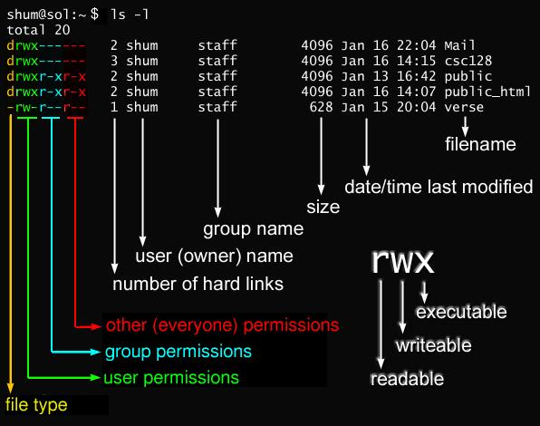
Now then, permissions…

Slide 13
Useful permissions commands
sudo: run a command as an administrative user
Some commands REQUIRE this. Other situations may relate back to permissions on the file/directory/user
UE1: sudo su
chmod: lets you change the permissions on a file or directory
MUST BE RUN AS SUDO
UE1: sudo chmod 777 test_dir1 ← THIS IS A BAD IDEA
UE2: sudo chmod 000 test_file1.txt ← NO ONE CAN ACCESS THIS (except for admins)
4 = read, 2 = write, 1 = execute
REGULAR FILES = 644, DIRECTORIES AND EXECUTABLE FILES = 755

Slide 14
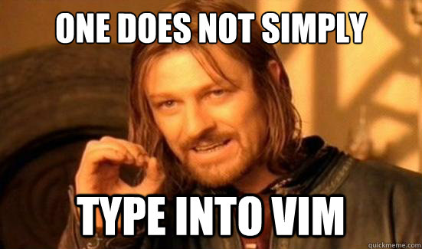
THE BEST TEXT EDITOR IN THE WORLD: VI / VIM!!
Comes with pretty much every distro of Linux
Very simple to use at a basic level, but has a LOT of depth to it if you want to get super good at it.
Open up your text file: vim test_file1.txt

Slide 15
The Basic Vim cheat sheet!
To type in vim, enter insert mode by hitting the ‘i’ key
Exit out of this by hitting ‘esc’
To shift into copy/cut/paste mode, enter visual mode by hitting the ‘v’ key
While in visual, you can use the keyboard to select lines of text!
You can copy a line of text by hitting the ‘y’ key in visual mode
You can paste by hitting the ‘p’ key
You can also cut using the ‘d’ key
To save and/or quit after editing, use the command mod (all commands start with ‘:’)
:w = save
:q = quit
:wq = save and quit
:w! = force write
:q! = force quit

Slide 16
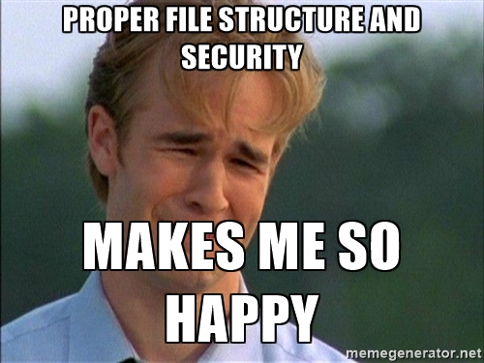
Now, let’s talk about the Linux Directory Structure!
If you do a cd / and an ls in there, you’ll see a bunch of directories in there.
Note: Directories are in blue, files are white!
Each of these directories hold a lot of important information, and are organized in a certain way!
So here’s what you need to know…

Slide 17
What’s inside…
home: home directories for all users
root: home directory for the root user (DO NOT MESS WITH THIS)
bin: Common single user linux commands/binaries
You’ll notice lots of yellow files in here…what does that mean?
etc: Configuration files + startup/shutdown scripts
var: ‘variable’ files, or files that are expected to grow in size
Database files (var/lib), log files (var/log)
boot: Boot loader files (kernel files)
usr: User programs for ‘second level’ programs
usr/bin: usually where you look if the command you’re running isn’t inside of /bin
proc: System process information

Slide 18

A few final-but important-commands
Updating and installing on your system: package managers
Different on a lot of distros
On CentOS, we use yum.
yum update
yum install <package name>
Archive + Compression: tar
tar czvf <name of file> <directory to compress>
tar xzvf <name of archive file>
You may also run into zip or bzip2 files – use your man pages!!!

Slide 19
Searching files and directories
Looking for a particular named file/directory? Use the find command.
find <directory to search> -name “<name of file/directory>”
find <directory to search> -type f -name “<name of file>”
Find has lots of cool options associated with it-MAN!!!
Need to look through your files to see if there’s a certain word? Use the grep command! (I really like this command)
grep -i “<string in file>” <file name>
grep -rni “<string in file>” <directory/to/search>

Slide 20
AND NOW YOU CAN DO STUFF IN LINUX!!!
If you have any questions, I know lots of stuff about Linux, so just come and ask!
Now it’s time to test your skills: http://overthewire.org/wargames/bandit/
THANK YOU FOR LISTENING!!!

